Slide 1
Municipal Government
Career Opportunities
Your name, Your title
Friday, May 22, 2020
Notes:
***Insert your name and title.***
Introduce yourself, your background, and your experience working in government.
How many of you have thought about what you want to be when you finish high school? What careers have you thought about?
Has anyone seriously considered a job in municipal government? No? Doesn’t that sound like an exciting career? Why does government not sound exciting?
Timing: Slides 1-5 = 10 minutes

Slide 2
Purpose
To understand the role of municipal government
To become familiar with the roles and responsibilities of government workers
To explore career opportunities available to you
Notes:
I’m here today to help you understand a little bit more about the role municipal government plays in our daily lives and the various jobs that the municipal government offers.
I hope that by the end of the session you will have a good understanding of the different roles and responsibilities of government workers and have a better idea of how you can explore the opportunities available to you now and in the future.
Timing: Slides 1-5 = 10 minutes

Slide 3
Levels of Government
Responsibilities
Notes:
Before we get into municipal government in more detail, I want you to think back to your social studies class in elementary school.
Do you remember learning about the three levels of government? What are the three levels?
Answer: Federal, Provincial, Municipal
Do you remember what each level is responsible for? Let’s see…
Timing: Slides 1-5 = 10 minutes

Slide 4
Levels of Government
Money
Water
Education
Federal
Municipal
Provincial
Fire Service
Health
Libraries
Municipal
Provincial
Municipal/Provincial
Sports Arena
Highways
Citizenship
Municipal
Provincial
Federal
Child Welfare
Postal Service
National Safety
Provincial
Federal
Federal
Cemeteries
Police Service
Sidewalks
Municipal
Municipal/Provincial
Municipal
Notes:
Activity: ask students to guess which level of government is responsible for each service, revealing the answers one at a time.
Timing: Slides 1-5 = 10 minutes

Slide 5
Relationship Model
CAO
RES
I DENTS
COUNCIL
SERVICE DESIRED/ DECISION MAKERS
CAO
STAFF
SERVICE DELIVERY
STAFF
Notes:
Today, we are going to focus on careers in municipal government.
When I talk about municipal government, there’s actually two parts to it. One, the side you’re probably most familiar with, is the political side. This is called the council; council members are responsible for setting the direction and policy for the municipality, they are the decision makers. The other side is the administration, consisting of the CAO and municipal staff.
Who knows what CAO stands for?
Answer: Chief Administrative Officer
The CAO is the administrative head of the municipality and is responsible for ensuring that council’s decisions are put into practice. This involves implementing policies and programs and overseeing the day-to-day operations of the municipality.
The staff are the people you will see sitting in the office issuing permits, or out in the graders cleaning your street.
Members of council stay out of day-to-day operations and concentrate on policy making and monitoring programs. Councillors work with the CAO to keep up to date on how the municipality is implementing their decisions.
We are going to explore the administration side, not the political side.
Timing: Slides 1-5 = 10 minutes

Slide 6
Municipal Government Services
Planning & Development
Public Transport
Electrical Distribution
Water Supply
Cemeteries
Community Services
Weed Control
Roads, walkways, lighting
Building Permits
Natural Gas Distribution
Airports
Police
Cultural Facilities
Parks and Facilities
Fire Protection
Emergency Management Services
Bylaw Enforcement
Garbage Collection
Recreation Programs
Sewage/Storm Sewers
Animal Control
Notes:
This is not a complete list of all services that municipal government can provide.
Are there any services on this list that you didn’t expect to see?
Are there any not listed that you would like to ask about?
Advise students as required.
Timing: Slides 6-13 = 10 minutes

Slide 7
True or False?
The mayor/reeve is the sole decision maker for a municipality
Notes:
Ask students to individually complete the quiz on page 3 of their handout.
If you choose to bring prizes or promotional items to distribute to the class, this may be one of the times you choose to award a prize.
Review as a whole group.
False - The mayor/reeve is considered the spokesperson for the municipality, which is why most of you may know of that person. However, a common misconception is that the mayor/reeve has more power in decision making than the rest of the council members but this is not true. The mayor/reeve only has one vote (just like a councillor).
Timing: Slides 6-13 = 10 minutes

Slide 8
True or False?
A municipal council can create bylaws, such as a curfew on teenagers, for the municipality
Notes:
True - The purpose of a municipality, among many things, is to develop and maintain safe and viable communities. Under the Municipal Government Act, council has the right to pass bylaws for a number of reasons, including protecting the safety, health and welfare of people and for the protection of people and property.
Bylaws receive three readings at a council meeting and those meetings must be open to the public. Therefore, residents have the opportunity to state their opinions for or against a bylaw before the third reading when the bylaw will be passed. Ultimately, it is council’s job to decide what is best for the whole community.
Timing: Slides 6-13 = 10 minutes

Slide 9
True or False?
Alberta consists of approximately 125 municipalities
Notes:
False - Ask students to guess the correct number.
Answer: 360
Timing: Slides 6-13 = 10 minutes

Slide 10
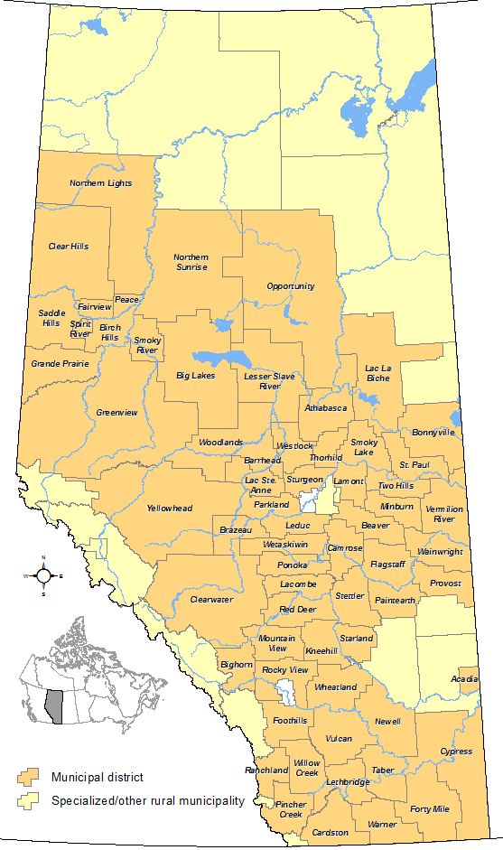
Map of Alberta
City = 10,000 people or more
Town = 1,000 people or more
Village = 300 people or more
Notes:
In Alberta, there are several different types of municipalities. The types you are probably most familiar with are cities, towns, and villages. Designations depend on the size of the municipality. A city contains 10,000 people or more, a town 1,000 people or more, and a village 300 people or more.
***Provide students with nearby examples.***
An example of a city is:
An example of a town is:
An example of a village is:
There are also other municipality types such as municipal districts and counties, but we aren’t going to look at these today.
Timing: Slides 6-13 = 10 minutes

Slide 11
True or False?
A municipal council decides where residential and commercial properties can be built
Notes:
True - Every municipal council must pass a land-use bylaw which divides the municipality into designated districts, outlines the types of land uses allowed in each area, and provides the planning standards (for example, distances from property lines, height restrictions).
Any municipality with a population over 3,500 is required to also have long-term land-use plan, called a Municipal Development Plan.
The purpose of these plans and bylaws is to achieve orderly, economical and beneficial development, and to maintain and improve the quality of the physical environment for the residents. It is council’s responsibility to decide what is best for the whole community.
To find out more information about the history of municipal government in Alberta, the roles and responsibilities of municipal officials, your own or any other municipality you are interested in, refer to the resources outlined on page 4 of your handout.
Timing: Slides 6-13 = 10 minutes

Slide 12
True or False?
Some senior position salaries in municipal government can exceed $100,000 a year
Notes:
True – some positions can exceed $100,000 per year. Salary, of course, will depend on the location and size of the municipality, and the qualifications and experience needed for that position.
Timing: Slides 6-13 = 10 minutes

Slide 13
True or False?
People with any type of degree or diploma can work in municipal government
45,900
Guess how many full-time
positions are available
in municipal government?
Notes:
True - The number and type of staff needed for any municipality depends on the size, location, and needs of that municipality. Therefore, each municipality has different staffing needs, each requiring different levels of education and experience.
Give students an opportunity to guess the number of positions of full-time municipal jobs available across Alberta.
Answer: There are approximately 45,900 positions available, and that does not include part-time or casual positions. That means there are a lot of very different job opportunities out there requiring varying levels of experience and education.
Timing: Slides 6-13 = 10 minutes

Slide 14
Working in Municipal Government
Staff Roles and Responsibilities
Notes:
***Prepare to deliver the following section based on the work in your municipality.***
Use the planning sheets provided in the Facilitator’s Guide to help you.
Timing: Slides 14-19 = 15-20 minutes

Slide 15
Career Opportunities
A
D
M
I
N
I
S
T
R
A
T
I
O
N
Chief Administrative Officer
Communications Officer
Business Analyst
Lawyer
Administrative Support Staff
Economic Development Officer
Notes:
Explain the core functions of each department and the main roles within each.
Draw on examples of the work being carried out by people in these job roles in your municipality – this can include a project that has recently been completed/is being worked on at present, or simply the daily responsibilities associated with a role.
Students will be interested in knowing the salaries associated with the various roles too.
Ask questions throughout to keep students engaged.
Timing: Slides 14-19 = 15-20 minutes

Slide 16
Career Opportunities
Human Resource Director
HUMAN RESOURCE SERVICES
Human Resource Assistant
Payroll and Benefits Coordinator
Grader Operator
PUBLIC
WORKS
Electrician
Engineer
Notes:
Explain the core functions of each department and the main roles within each.
Draw on examples of the work being carried out by people in these job roles in your municipality – this can include a project that has recently been completed/is being worked on at present, or simply the daily responsibilities associated with a role.
Students will be interested in knowing the salaries associated with the various roles too.
Ask questions throughout to keep students engaged.
Timing: Slides 14-19 = 15-20 minutes

Slide 17
Career Opportunities
Planner
LAND-USE PLANNING
GIS Coordinator
Development Officer
Police Officer
PROTECTIVE
SERVICES
Bylaw Officer
Firefighter
Paramedic
Notes:
Explain the core functions of each department and the main roles within each.
Draw on examples of the work being carried out by people in these job roles in your municipality – this can include a project that has recently been completed/is being worked on at present, or simply the daily responsibilities associated with a role.
Students will be interested in knowing the salaries associated with the various roles too.
Ask questions throughout to keep students engaged.
Timing: Slides 14-19 = 15-20 minutes

Slide 18
Career Opportunities
U
T
I
L
I
T
I
E
S
F
I
N
A
N
C
E
Finance Officer
Refuse Collector
Tax Officer
Water Plant Operator
Assessor
Recycling Coordinator
Notes:
Explain the core functions of each department and the main roles within each.
Draw on examples of the work being carried out by people in these job roles in your municipality – this can include a project that has recently been completed/is being worked on at present, or simply the daily responsibilities associated with a role.
Students will be interested in knowing the salaries associated with the various roles too.
Ask questions throughout to keep students engaged.
Timing: Slides 14-19 = 15-20 minutes

Slide 19
Career Opportunities
Lifeguard
RECREATION AND CULTURE
Library Clerk
Recreation Director
Family Support Worker
FAMILY AND COMMUNITY SERVICES
Youth Programmer
Counsellor
Notes:
Explain the core functions of each department and the main roles within each.
Draw on examples of the work being carried out by people in these job roles in your municipality – this can include a project that has recently been completed/is being worked on at present, or simply the daily responsibilities associated with a role.
Students will be interested in knowing the salaries associated with the various roles too.
Ask questions throughout to keep students engaged.
Timing: Slides 14-19 = 15-20 minutes

Slide 20
Building a Recreation Centre
Working in pairs consider:
Who will be involved in the process?
Why will they be involved? What are their responsibilities?
Notes:
Now that you have a broad idea of the kinds of jobs available in municipal government, working with a partner, consider who would be involved with in the process for building a Recreation Centre.
Imagine, it has just been agreed by council to use a parcel of undeveloped land for this project. Remember, once a decision like this is made by council, it is up to the administration to decide how best to implement it.
Think about who would be involved with this project from start to end and why.
Use the space provided on page 6 of your handout to note your thoughts. You can refer to the list of career opportunities we just discussed on page 5 – feel free to add any other jobs not listed that may be relevant and a responsibility of municipal government.
You have 10 minutes to work on this task before we will discuss it as a whole group.
Timing: Slide 20 = 10 minutes

Slide 21
Building a Recreation Centre
Debrief
Notes:
Ask students to provide feedback on what they came up with and fill in any obvious blanks that may arise.
The two key take away points from this activity are:
You should now have a sense of what municipal government is like and the kinds of issues municipal officials deal with on a daily basis.
There are many career opportunities in municipal government. A municipality’s administration requires a wide range of skilled people from different disciplines so there is a good chance of you fining a career opportunity that aligns with your education and skills, regardless of what you study at university.
On page 7 of your handout there is a sample list of municipal government careers and the typical educational requirements for each position.
Timing: Slide 21 = 10 minutes

Slide 22
Getting Involved
Opportunities for today and tomorrow
Notes:
Hopefully right now you are intrigued about municipal government and the opportunities it may offer you. There are many ways in which you can find more information…
Timing: Slides 22-26 = 15 minutes

Slide 23
Finding a Job in Municipal Government
Association websites
Municipality websites
Government of Alberta - Municipal Affairs website
Alberta Learning Information Services website
Notes:
Just as teachers and doctors belong to associations, there are also associations for municipalities. Each of these associations has a website with more information about municipal government, and a listing of job openings around the province. Page 8 of your handout provides links to each one.
You can contact each municipality directly. Many municipalities have websites you can look at to find out more about them. They may even have summer, temporary and permanent positions listed.
***Provide your municipality’s website to students.***
You may also want to get involved in your municipality by attending council meetings or by sitting on a board. Most municipalities have different agencies, boards, and commissions (ABCs) that look for residents’ participation and some boards may specifically look for student participation. You can find this information on your municipality’s website.
You can visit the Government of Alberta - Municipal Affairs website to find out about the provincial government’s role and how it works with municipal government.
If you are looking for ideas, tips, or assistance with your career development, the Alberta Learning Information Service website is worth a visit.
Timing: Slides 22-26 = 15 minutes

Slide 24
Municipal Internship Program
For recent college or university graduates:
12- or 24-month paid position
Rotate through key departments
Starts in May each year
Visit the Municipal Internship Program webpage for more information and updates
Notes:
For those of you who are interested in a career in municipal government but are not sure what area you would like to work in, the Municipal Internship Program may be a post-graduation possibility for you.
The program is for recent university or college graduates with a diploma or degree in any discipline who are interested in starting their career in municipal administration, municipal finance, or municipal land use planning. The internship is a 12 or 24-month paid position and provides you with the opportunity to get a broad understanding of the key functional areas in a municipality.
You can find more information on the Municipal Internship Program web page - the link is provided on page 9 of your handout.
Timing: Slides 22-26 = 15 minutes

Slide 25
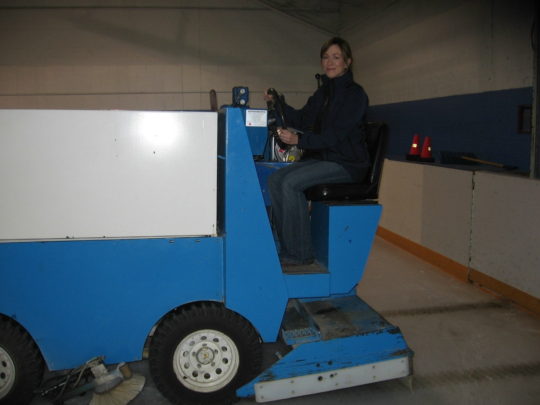
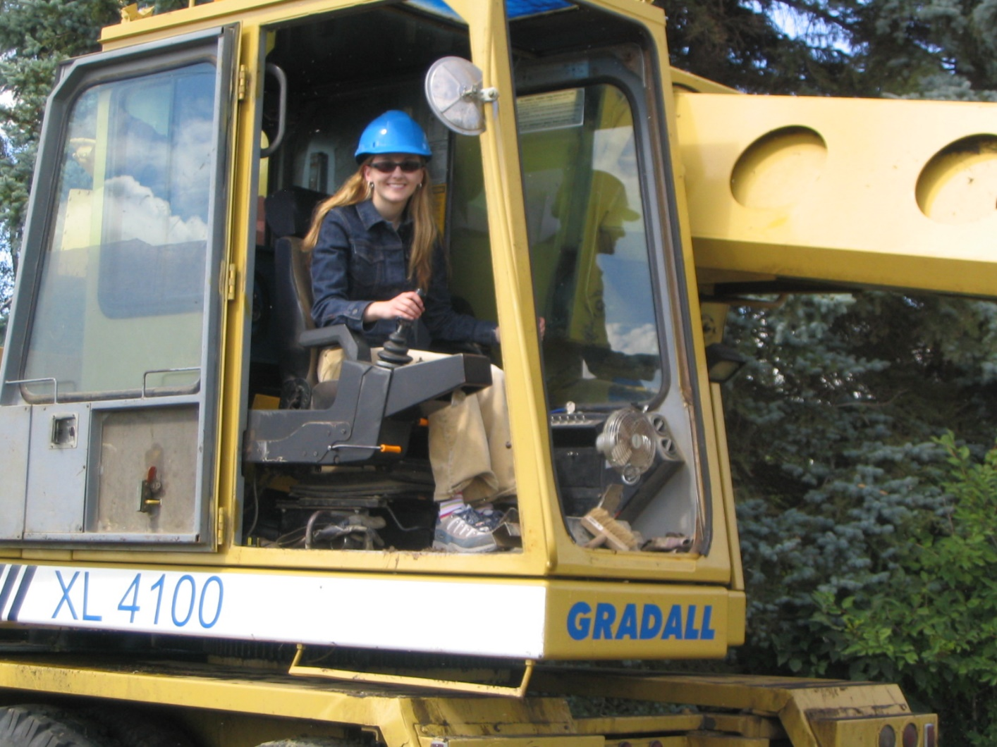
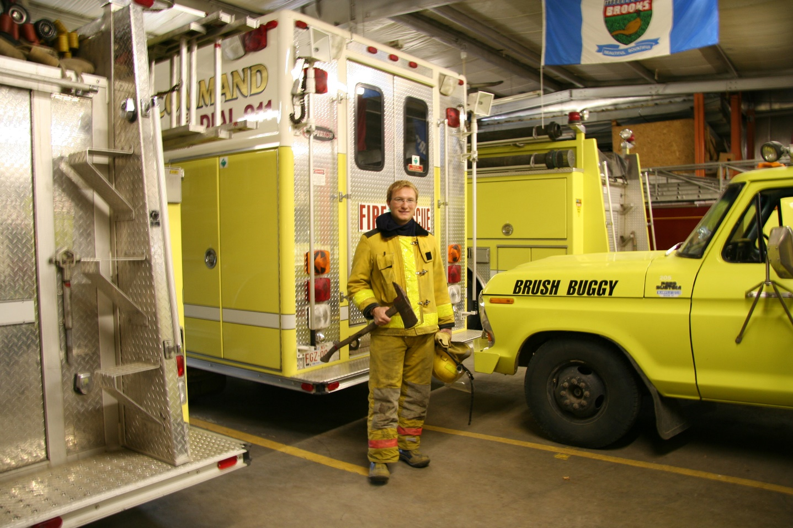
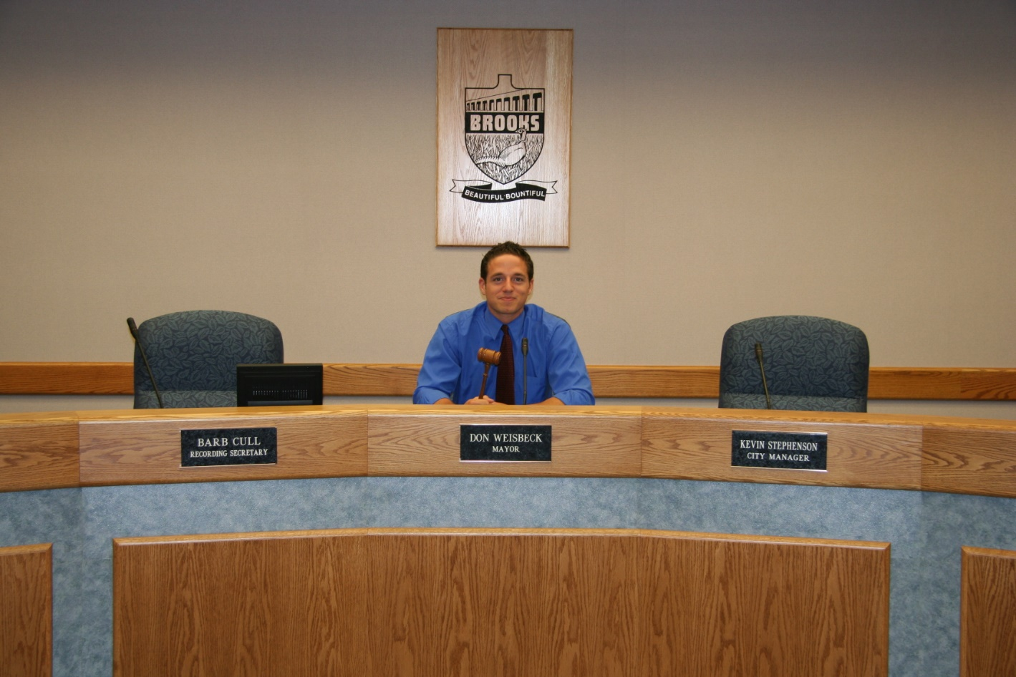
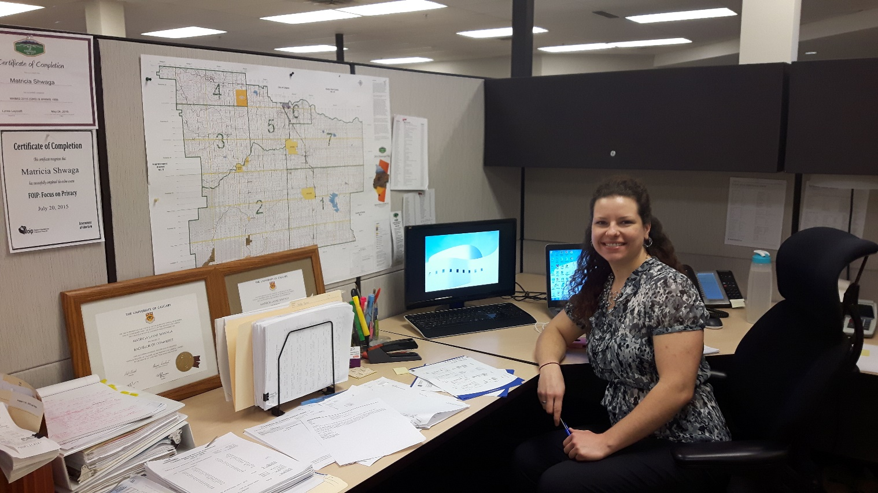
What being an intern can look like…
Notes:
Here is a sample of work past interns have been involved with to give you an idea of how diverse working for municipal government can be.
As you can see, it can range from working with council, public works and protective services to working in an office.
Timing: Slides 22-26 = 15 minutes

Slide 26
Rewards
Working for a government that most closely affects people
Working for the betterment of your community
Fast-paced job with lots of variety
Can work in the office, the field, or both
Transferable skills to anywhere in Canada
Compensation package
What are some of the benefits of
working in municipal government?
Notes:
Ask students for their input before revealing and going through the list.
Working for a government that most closely affects people
Working towards the betterment of the community you live in; a position with direct impact on the community
Fast-paced job with lots of variety;
Have the option of an office job, or a job in the field, or both
Great opportunity to move around to different positions and to different places around Alberta (even around Canada)
Stability – governments will always be around
Compensation – vacation time, statutory holidays, salary, and pension
***Tell students why you find it rewarding to work for municipal government.***
Timing: Slides 22-26 = 15 minutes

Slide 27
Questions?
Notes:
Allow time for questions and answers.
After questions have been addressed, ask students to complete an evaluation form.
Timing: Slide 27 = 10 minutes
Evaluation Forms = 5 minutes

